Slide 1

OSM in Government
The US Census Bureau Experience
This document licensed in entirety by Creative Commons CC-by-SA. For specific terms of license, see: http://creativecommons.org/licenses/by-sa/3.0/

Slide 2
Overview
US Census Bureau’s TIGER/Line & OSM: the Nexus
Case Study
Questions for Research

Slide 3
The Rational Nexus
Where Census operations meet OpenstreetMap

Slide 4
US Census Bureau: The Basics
US Census Bureau is a statistical agency
The largest Federal statistical agency
Data is central to the Bureau’s mission
US Census Bureau conducts:
Censuses – a complete count
Examples: Decennial, Economic
Surveys – drawn from a representative sample
Examples: American Community Survey, Current Population Survey, American Housing Survey, etc.
Geospatial data are essential to these operations

Slide 5
US Census Furnishes Data
Data is at the core of the Bureau’s mission
Data as an explicit public good
Embodied in Mission Statement
Strong Geospatial Component to Data:
Master Address File
Not public -- Protected by Title 13
Contains position by latitude/longitude for housing units, group quarters
TIGER/line
Public domain
Transportation features, boundaries

Slide 6
A Brief History of TIGER
Mid ‘80s, Census Bureau & USGS make 1st nationwide digital street map with address ranges.
Evolved into TIGER for 1990 decennial census
Early ‘90s - Local governments bootstrap GIS with TIGER data
Early ‘90’s - NAVTEQ, TeleAtlas started with TIGER data
‘96, MapQuest deploys Web-based system with street address & map display.
2008 - OpenStreetMap receives a jump-start by importing TIGER
TIGER data provided a foundation for GIS and launched the geospatial industry.

Slide 7
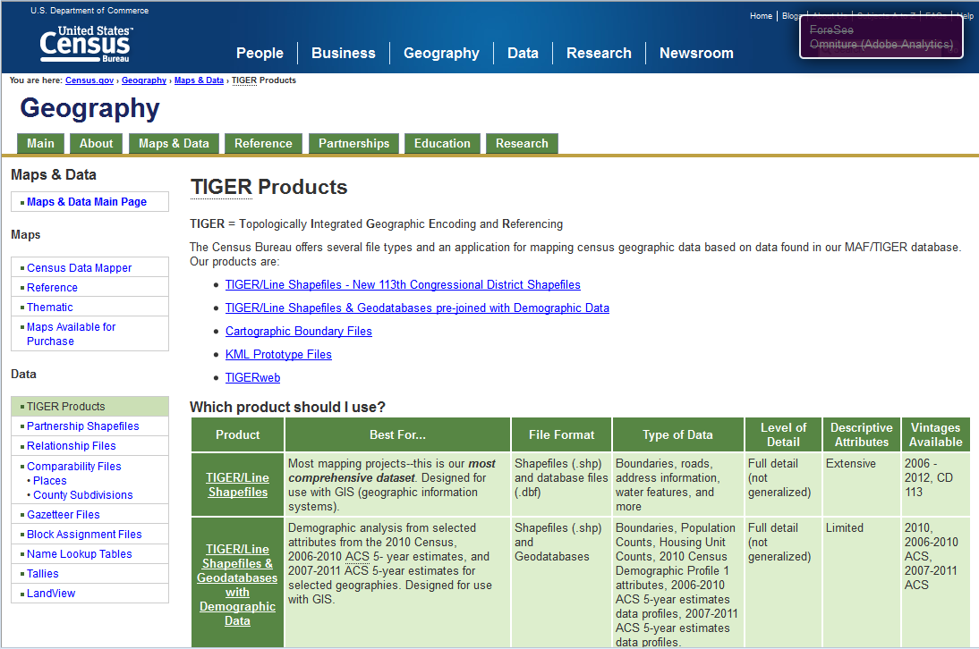
TIGER today…

Slide 8
The Nexus with OpenStreetMap
OpenStreetMap is a large & growing constituency for Census Bureau geographic data:
Continued attention to TIGER 2012 for import
Ongoing fixes to TIGER 2007 base
Local knowledge used to supplement & correct TIGER
OpenStreetMap gives Bureau professionals exposure to geographic issues that face the Bureau:
Locating features in the real world
Describing real world features
Familiarity with field-based issues

Slide 9
OpenStreetMap at Census Bureau
Case Study

Slide 10
Starting an OpenStreetMap Working Group
Informal group, multiple interests, casual to more formal
Working across Census Bureau organizational divisions
Current project: Map Suitland Federal Center
Regular mapping parties planned through September

Slide 11
Getting into OpenStreetMap at Census
Experience Open Source methods of production
Collaboration
Gain understanding of OpenStreetMap project ethos
Understand Field Operations
Engage with geography on a 1:1 scale
How do we describe real world features?
What roles do Citizen Geographers play?
How can the Bureau collaborate with OpenStreetMap?
Cross-division Collaboration
What are the geographic issues that span the Bureau Divisions?

Slide 12
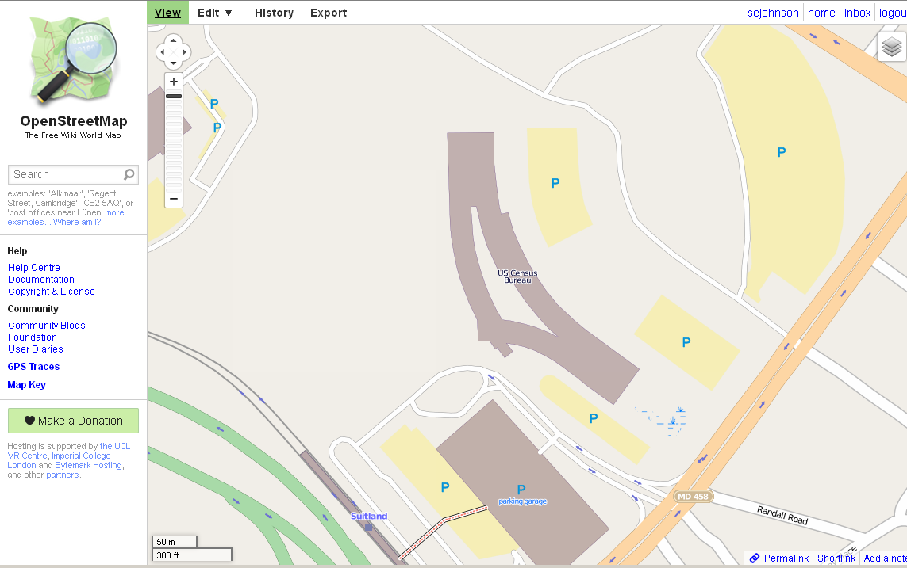
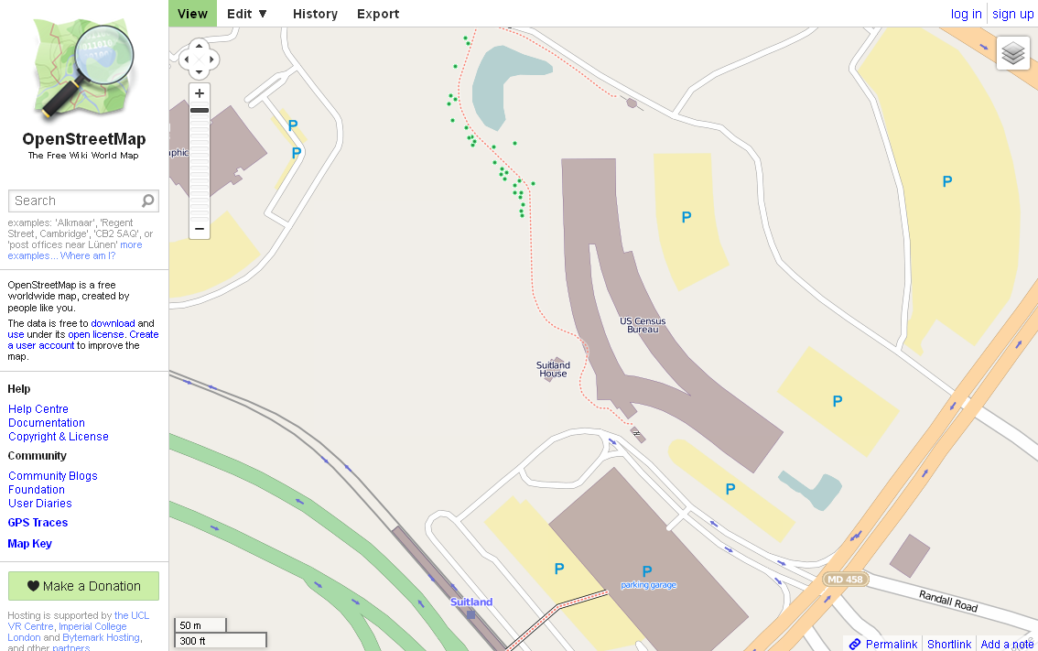
Adding Detail to Suitland Federal Center

Slide 13
Research Questions
Lines of inquiry

Slide 14
Hypothesis
The OpenStreetMap project and Government Agencies can mutually benefit through collaboration.

Slide 15
Motivations for Participation in OSM
Individual
Outreach & forging bonds in the community
Contributing to the public knowledge commons
Interacting with geography
Satisfaction of seeing your work
Institutional
Change detection
Improve data currency and integrity
Find features not collected by other institutions, or agencies

Slide 16
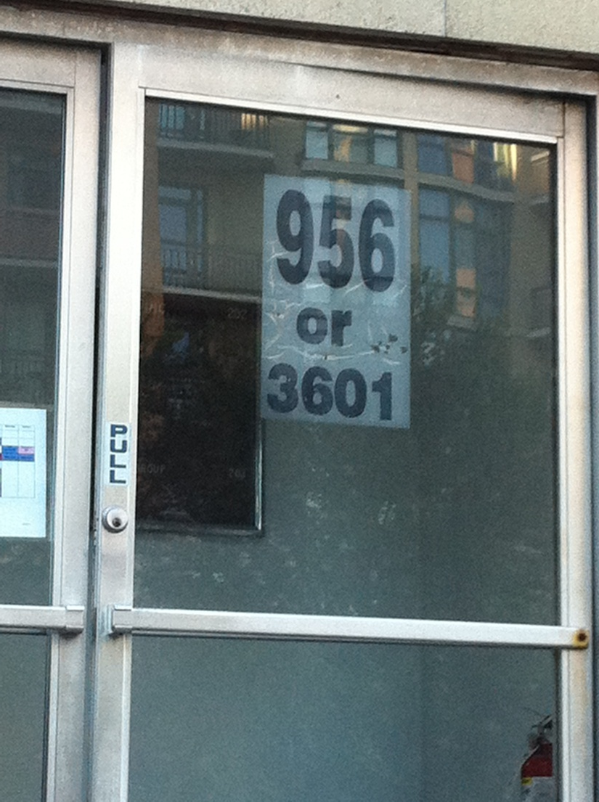
Thinking like a Census Field Representative
How to describe real world features?
How do you deal with ambiguous addresses?
How do you tag mixed use buildings?
What guides your judgment?
How descriptive should you be?

Slide 17
OSM – Government relationship
The OSM community relies on Census Bureau data
TIGER import in ’07 and subsequent refinements
There is a large natural constituency for TIGER data
Encouraging a community of citizen scientists can yield benefits for the Census Bureau
Public agencies need a constituency for their data.
Collaboration between Census & OpenStreetMap project can be mutually beneficial.

Slide 18
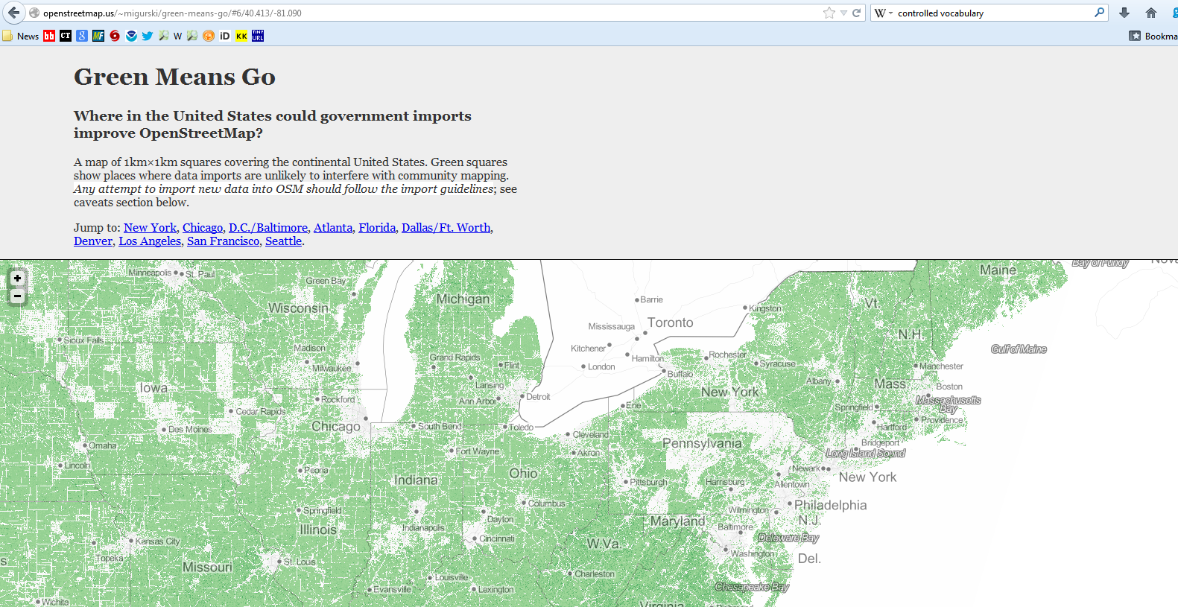
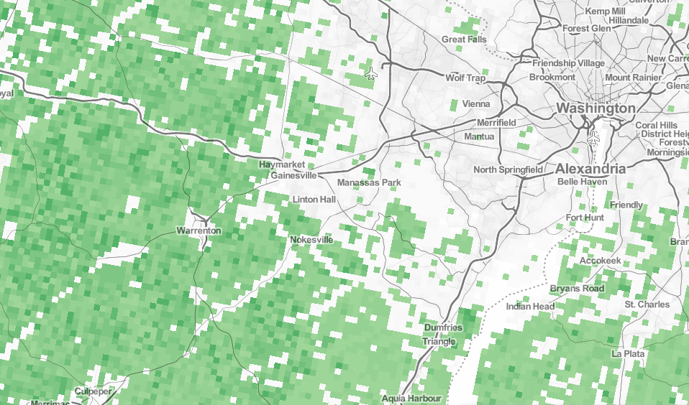
Tools for TIGER – OSM Data Quality
Credit: Michal Migurski

Slide 19
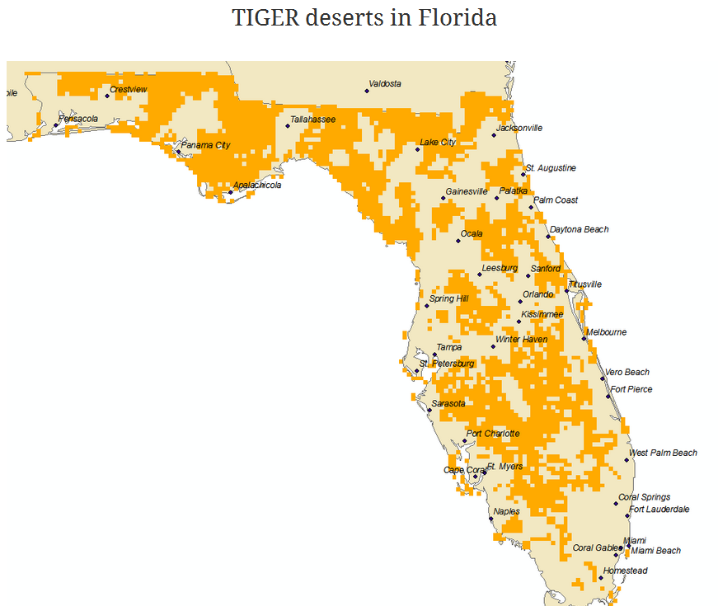
Finding TIGER Deserts
‘TIGER Deserts’ are areas where the original TIGER import is largely untouched by OpenStreetMap mappers.
Credit: Martijn Van Exel

Slide 20
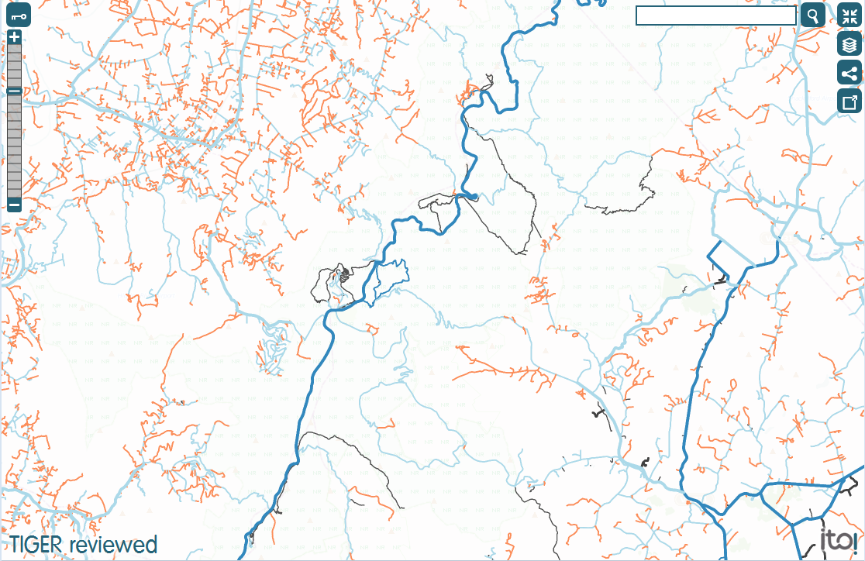
ITO World’s TIGER Reviewed Tool
Ways tagged with TIGER_reviewed=no
Credit: ITO World

Slide 21
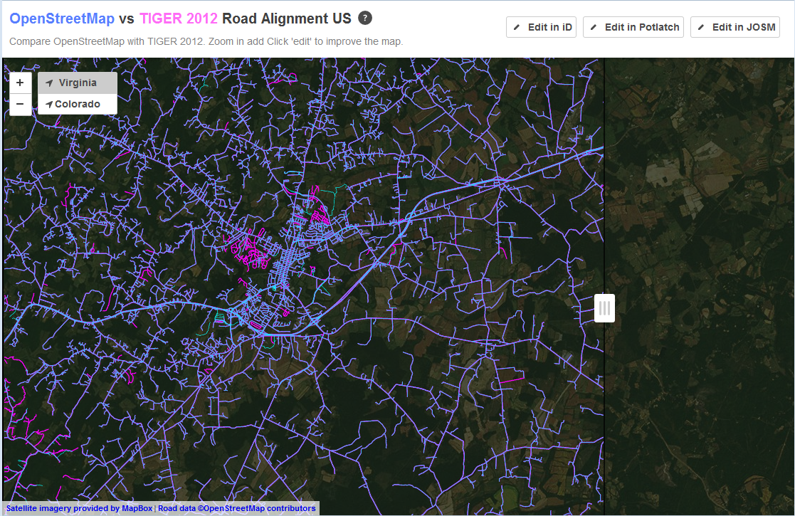
Mapbox TIGER/OSM Comparison
Credit: Mapbox

Slide 22
Do We Need A Set of Metrics?
Index for comparison and conflation:
Completeness
Currency
Positional Accuracy
Referential Integrity
Authority & Trust

Slide 23
OSM Presents Challenges to the Bureau
Challenges to Work Flow
Trained professional vs amateur enthusiast
Formal DB design vs Tag chaos
Challenges to Data Standards
Authoritative data vs crowd-sourced
Positional accuracy vs Temporal Currency
Formal metadata vs informal tagset comments
Challenges to Access & Availability
ODbL vs Public Domain

Slide 24
Where next?
OpenStreetMap is a large & natural constituency
The OSM community can benefit from a better understanding of Census Bureau operations & data
The OSM community scrutinizes TIGER data quality
The OSM community has made significant corrections & additions to the original TIGER base import
Tools are available to compare OSM & TIGER data
The Bureau can benefit from an OSM relationship
OSM community is a large constituency for Census data
OSM platform for public collaboration
Citizen engagement can augment Bureau’s location intelligence

Slide 25
Summary
Continued investments in public data depend on strong constituency of active users.
For Census Bureau, OpenStreetMap offers…
A constituency for the Bureau’s data products
A source of citizen collaborators
For OpenStreetMap, the Bureau offers…
Technical expertise
A universal mandate

Slide 26
Thank You
Questions? Comments?
Steven Johnson
(e) stevejohnson@deloitte.com
(t) @geomantic
This document licensed in entirety by Creative Commons CC-by-SA. For specific terms of license, see: http://creativecommons.org/licenses/by-sa/3.0/

